Slide 1
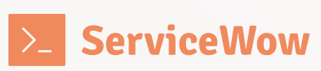
Sovereign Bank Workshop CMDB & CSDM
Group 7 – Now Architects
ServiceWow
Notes:
Hello, my name is Eric Jehl, and I have nine years of experience in ServiceNow with a focus on IT Service Management. Today, this workshop will help you understand how to leverage the Configuration Management Database (CMDB) and the Common Service Data Model (CSDM) to maximize, during your project, the benefits of ServiceNow.

Slide 2
Agenda
ServiceNow capabilities
CMDB Project Overview
Key takeaways
Problem Statement
Data Model
Notes:
The first part will help you understand the key concepts of the CSDM Data Model, and we will explore how to apply them in a Change Management scenario.
In the second part, I will introduce some key elements of ServiceNow's capabilities
In the third part, I will present the different steps for implementing your CMDB/CSDM project, providing a clear roadmap for a successful deployment.
As a conclusion, I will recap the key points of the presentation, reinforcing the essential concepts and takeaways.
Data Model
CSDM capabilities (3 notions of Application (BA, AS, Application CI), 3 notions of Services (BS, SO, TS, AS)
Exemple with change Management Service Owner Approve a group
ServiceNow capabilities
CMDB Key elements
Health dashboard
Data certification
CSDM & CMDB Automation
CMDB Project Overview
Next Steps
Conclusion

Slide 3
Problem Statement
Lack of structure
Data is inconsistent and scattered
Remedy is highly customized
Resistance to change
Business Impact
Notes:
Sovereign Bank's Remedy system is highly customized, making CMDB governance difficult.
Data is inconsistent and scattered across different tools with no unified model.
Resistance to change exists due to long-standing processes and fragmented ownership.
Business impact: Inefficiencies, difficulty in service ownership identification, and compliance risks.

Slide 4
Problem Statement
Remedy is highly customized
Data is inconsistent and scattered
Resistance to change
Business Impact
Notes:
Sovereign Bank's Remedy system is highly customized, making CMDB governance difficult.
Data is inconsistent and scattered across different tools with no unified model.
Resistance to change exists due to long-standing processes and fragmented ownership.
Business impact: Inefficiencies, difficulty in service ownership identification, and compliance risks.

Slide 5
Why CMDB & CSDM?
CSDM standardizes data across ITSM, ITOM, and HR
Aligns application and service portfolios
Automated discovery & data certification
Supports scalability across Sovereign Bank Group
5
Notes:
CSDM standardizes data across ITSM, ITOM, and HR → Provides a single source of truth.
Aligns application and service portfolios → Enables clear service ownership in Change Management.
Automated discovery & data certification → Reduces technical debt and ensures CMDB accuracy.
Supports scalability across Sovereign Bank Group → Future-proof and integrates with ITOM.

Slide 6
Why CMDB & CSDM?
CSDM standardizes data across ITSM, ITOM, and HR
Aligns application and service portfolios
Automated discovery & data certification
Supports scalability across Sovereign Bank Group
6
Notes:
CSDM standardizes data across ITSM, ITOM, and HR → Provides a single source of truth.
Aligns application and service portfolios → Enables clear service ownership in Change Management.
Automated discovery & data certification → Reduces technical debt and ensures CMDB accuracy.
Supports scalability across Sovereign Bank Group → Future-proof and integrates with ITOM.

Slide 7


Data Model: What is an application ?
Oracle Developer :
My Database is an application
Everyone is right :
we need a unified data model
Solution Architect
My application stack is an application : it’s set of software components (web server, middleware, database).
Enterprise Architect
An application respond to a Business need, it’s a Business Application
7
Notes:
Now that we understand why a well-structured CMDB and CSDM framework are essential for Sovereign Bank, the next step is ensuring that we correctly classify and structure our data. A key part of this is understanding how applications fit within the data model—what defines an application, how it relates to services, and why this classification is critical for governance, automation, and accurate reporting.
To start, when you're in a company and you ask three different people, "What is an application?", you'll likely get three different answers.
These people are saying three different things, but everyone is right: what we need is a unified model to organize these elements, and this is where the CSDM comes in.

Slide 8
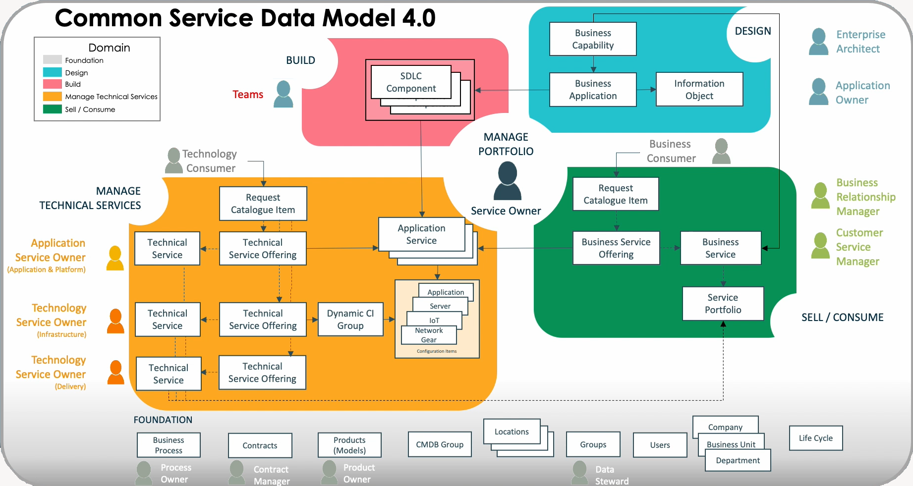
Data Model: Application Axis
Application Axis
Business Application
Ex : Credit check
Instance stack
Ex : Credit Check DEV, Credit Check PROD
DB, CIs in the CMDB
8
Notes:
So, these three different applications will be organized in three different places:
And we can draw an Application Axis :
The Blue Axis allows navigation through CSDM from different Application perspectives:
Business Application represents the business view, delivering value to the organization.
Application Service is an IT service that supports and delivers a Business Application.
Application CI consists of technical components managed in the CMDB.

Slide 9
Data Model: Services Axis
Service Axis
Deployent view
Credit Check PROD
Consumer view
Loan Money
IT Provider
TS : Financial Service
TSO : Check Credit
9
Notes:
The previous diagram presented the CSDM from an application perspective, and now I will present it from a services perspective.
Consumer view
From the client's perspective, the Business Service "Loan Money" is the service offered by the bank
To load Money, the bank has different offers for its clients like Consumer loan or House Loan
IT Provider :
The Technical Service represents the overall Credit Check processing
The Technical Service Offering defines its delivery options and also the support group and the approval group
Deployment view :
I already presented you the Application Service is an IT service that supports and delivers a Business Application.
The Service Axis represents who consumes an Application and how it is maintained

Slide 10
Data Model: Application Service
Application Service : The place where Application and the Services are meeting
10
10
Notes:
The Application Service acts as the bridge between a Business Application, The Business Service and the Technical Services,
And it ensures that the Customers can interact with it through there offering ,And the IT Services can continue to deliver and maintain it.

Slide 11
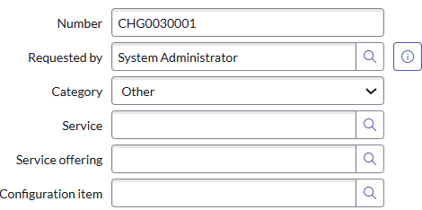
Data Model: Example with Change Management
Check Credit
Business Application
Financial Service
Technical Service
Consumes
parent
Check Credit
Technical Service Offering
Contains
Check Credit PROD
Application Service
TS Financial Service
TSO Check Credit
AS Check Credit / CI
Support Group
FS_TS_Support_Check_Credit
Depends on
1
The Change Requestor fills the Technical Service
Approval Group
FS_TS_Approval_Check_credit
2
Depending on the TS, he fills the Service Offering
3
Depending on the SO, he selects the CI
4
After submission, he asks for approval :Depending on the Change Process and its approvals rules, a member of the SO Approval group must approve to continue
Application
Server
Middleware
CMDB
11

Slide 12
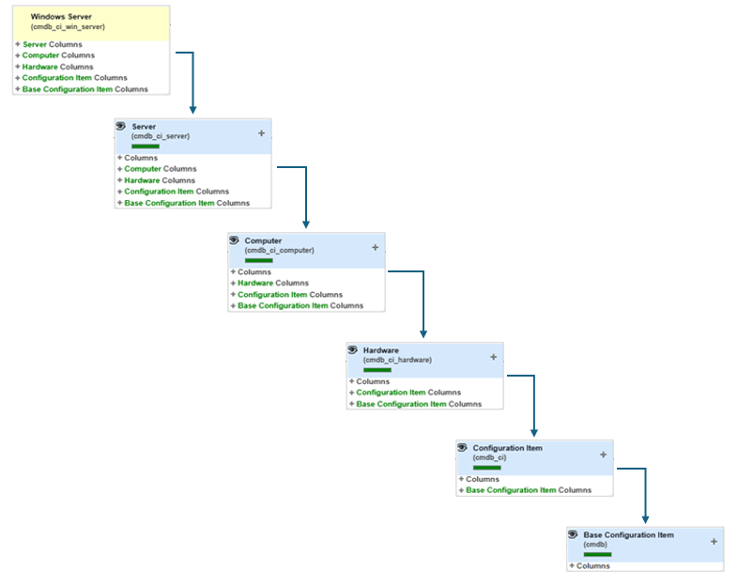
ServiceNow capabilities: CMDB Key elements
Structuration based on class et inheritance
Principal class
Identify the key classes to be used in your ITSM process
Example : Application Service, Server, Database, …
IRE : Identify and Reconciliation Engine
When integrating with the configuration management database (CMDB), you can prioritize certain discovery sources over others to ensure more relevant and accurate data.
12
12
Notes:
In ServiceNow CMDB, the structuration is based on class and inheritance, allowing for a hierarchical organization of configuration items (CIs) where child classes inherit attributes and behaviors from parent classes
The Principal classes refers to the key classes in the CMDB that are of primary interest and are presented in IT processes, such as Incident or Change
The Identity and Reconciliation Engine will enable ServiceNow to interface with various data sources, and also weighting the trust level of each data source.

Slide 13
ServiceNow capabilities: CSDM & CMDB automation
Check Credit
Business Application
Consumes
Service Mapping identifies and visualizes the relationships between Application Services and their underlying IT infrastructure, providing a clear, real-time view of service dependencies.
Check Credit PROD
Application Service
Depends on
Application
Discovery automatically scans the IT infrastructure to identify, map, and update Configuration Items (CIs) in the CMDB, ensuring accurate and up-to-date asset information.
Server
Middleware
CMDB
13
Notes:
To ensure a high-quality CMDB, we will implement Discovery.
To establish the relationship between Application Services and the CMDB, we will deploy Service Mapping.

Slide 14
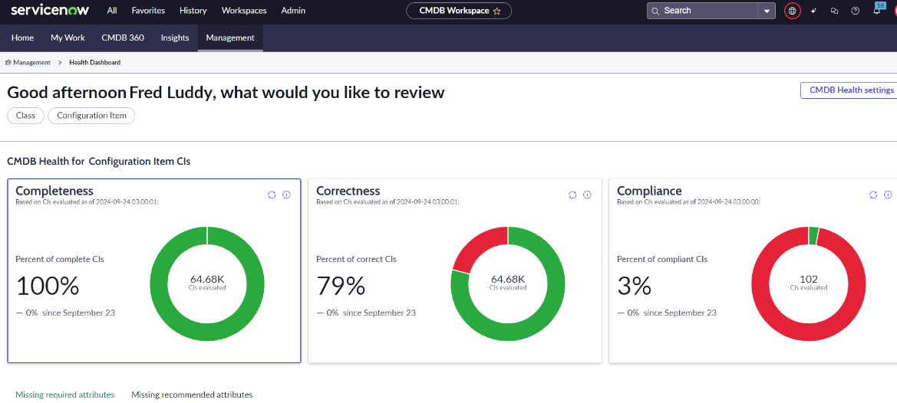
ServiceNow capabilities: CMDB Health
CMDB Workspace v7.0 required for these features Upgrade Admin>Application Manager
Monitors and reports the health of the CMDB through key performance indicators (KPIs) and their sub-metrics:
Completeness: Checks for required and recommended fields in CIs that are unfilled
Correctness: Evaluates CIs against data integrity rules
Compliance: Audits CMDB data for adherence to established standards and certificates
Relationships: Assesses the integrity of CIs relationships
Are there unacceptable numbers of duplicates, orphans or stale CIs?
Are CI fields populated adequately
(e.g. owner, location, serial number)?
Does CI configuration states meet policies (e.g. minimum patch level, AV software installed)?
14
Notes:
The health of the CMDB data is monitored and reported for the following KPIs :
Completeness: CIs are tested for required and recommended fields that are not populated. (Support Group, Serial Number for the Servers)
Correctness: CIs are tested against pre-defined data integrity rules such as identification rules and we will detect duplicate CIs
Compliance: The CMDB data is audited for adherence to pre-defined certificates.
Relationships: The health of CI relationships is tested to check orphan or duplicate relationships
Those KPI are reported in the Health Dashboard
and for compliance with suggested relationships, hosting and containment rules.
After CIs are tested for various health indicators (metrics), the results are aggregated at the class, health group, service, and relationship level, and appear on CMDB Health dashboards. For most metrics, you can configure the health tests themselves to determine how compliance and non-compliance of CIs are evaluated.
--------------------------------------------------------
Monitors and reports the health of the CMDB through key performance indicators (KPIs) and their sub-metrics:
Completeness: Checks for required and recommended fields in Configuration Items (CIs) that are unfilled
Correctness: Evaluates CIs against data integrity rules, including:
Duplicate detection
Orphan CI identification
Stale CI monitoring
Compliance: Audits CMDB data for adherence to established standards and certificates
Relationships: Assesses the integrity of CI relationships by identifying:
Orphan and duplicate relationships
Compliance with suggested relationships and containment rules

Slide 15



ServiceNow capabilities: Data certification
Data Certification manages scheduled and on-demand validations of the CMDB
Regulatory or procedure reason requires a check for accuracy and certification
Consumers of the data, for instance a service desk or support team member can trust they are using accurate information
Certify specific fields on specific tables, inspect what you expect
15
Notes:
Data Certification in ServiceNow is a process where stakeholders validate the configuration item data to ensure the CMDB remains high-quality and aligned with business needs.
Data certification doesnt require a license

Slide 16
ServiceNow capabilities: Data certification
Data Certification manages scheduled and on-demand validations of the CMDB
Regulatory or procedure reason requires a check for accuracy and certification
Consumers of the data, for instance a service desk or support team member can trust they are using accurate information
Certify specific fields on specific tables, inspect what you expect
16
Notes:
Data Certification in ServiceNow is a process where stakeholders validate the configuration item data to ensure the CMDB remains high-quality and aligned with business needs.
Data certification doesnt require a license

Slide 17
ServiceNow capabilities: Data certification
Certify specific fields on specific tables, inspect what you expect
Regulatory or procedure reason requires a check for accuracy and certification
Consumers of the data, for instance a service desk or support team member can trust they are using accurate information
Data Certification manages scheduled and on-demand validations of the CMDB
17
Notes:
Data Certification in ServiceNow is a process where stakeholders validate the configuration item data to ensure the CMDB remains high-quality and aligned with business needs.
Data certification doesnt require a license

Slide 18




CMDB Project Overview – Steps
Crawl
Walk
Run
Fly
Foundation & Data Cleansing
Automate discovery & enforce governance
Optimization & ITOM Integration
Full Maturity & AI-driven Insights
Notes:
Prerequisites : The teams in charge of the CMDB is already defined
Crawl – Establish CMDB baseline (data cleansing, CSDM alignment, stakeholder engagement).
Walk – Automate discovery & enforce governance (role-based ownership, change approvals).
Run – Integrate ITOM, service mapping, and compliance monitoring.
Fly – Predictive insights, AI-driven automation, and full ITSM-ITOM maturity.

Slide 19
Crawl Foundation & Data Cleansing
Establish CMDB baseline by cleaning and normalizing existing CI data
Align data structure with CSDM to ensure proper classification of applications and services
Notes:
Establish CMDB baseline by cleaning and normalizing existing CI data.
Align data structure with CSDM to ensure proper classification of applications and services.

Slide 20
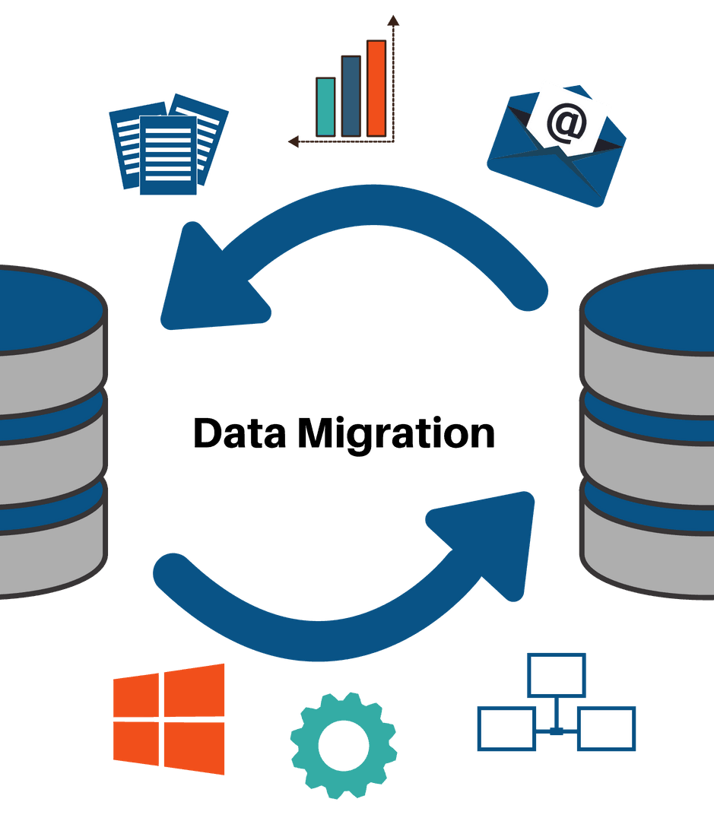
Walk Automate discovery & enforce governance
Implement automated discovery tools to maintain accurate CI records.
Define ownership and governance roles (e.g., service owners, change approvers).

Slide 21
Run Optimization & ITOM Integration
Integrate Service Mapping and ITOM Visibility for real-time dependency tracking
Enforce data certification processes to maintain CMDB health and compliance
Notes:
Integrate Service Mapping and ITOM Visibility for real-time dependency tracking.
Enforce data certification processes to maintain CMDB health and compliance.

Slide 22
Fly Full Maturity & AI-driven Insights
Enable predictive analytics and AI-driven automation for proactive IT management
Extend CMDB insights to support enterprise-wide decision-making and risk reduction
Notes:
Enable predictive analytics and AI-driven automation for proactive IT management.
Extend CMDB insights to support enterprise-wide decision-making and risk reduction.

Slide 24
CMDB Project Overview – Steps
Step 1
Step 2
Step 3
Step 4
Define the CSDM / CMDB Data model
Create an interface
Activate Discovery
Activate Service Mapping
Notes:
Prerequisites : The teams in charge of the CMDB is already defined

Slide 25
Define the CSDM / CMDB Data model
Activate Health Dashboards and Data Certification
Load Data in CSDM tables and make ServiceNow the golden source if possible
Notes:
Clarify how we are going to use CSDM in the client platform
Each different table will define different sections
All the tables will be syncronized in a specific way to allow the ...... (?????)
Maybe explain what CSDM tables are

Slide 26
Create an interface
Create an interface between the Remedy’s CMDB and ServiceNow’s CMDB to load as a minimum the principal Classes and there relationship (no big bang approach)

Slide 27
Activate Discovery
Activate Discovery and each time a new perimeter is configured, deactivate the concerned Remedy interface

Slide 28
Activate Service Mapping
Activate Service Mapping and map your Services with the CMDB infrastructure
When ServiceNow CMDB is the golden source :
Deactivate Remedy

Slide 29

Next steps
Ensure Data Quality & Governance – Regularly audit and certify data accuracy using Data Certification and Health Dashboards.
Integrate with ITSM
Plan a phased rollout
ServiceNow recommendation :
How to configure incident management to align with CSDM
Notes:
In the ITSM Process, put the Service field as Read Only and fill it automatically
https://www.youtube.com/watch?v=pVW5QJzzBkE
Plan a phased rollout → Ensure adoption before expanding across Sovereign Bank Group.

Slide 30
Next steps
Ensure Data Quality & Governance – Regularly audit and certify data accuracy using Data Certification and Health Dashboards.
Integrate with ITSM
Plan a phased rollout
ServiceNow recommendation :
How to configure incident management to align with CSDM
Notes:
In the ITSM Process, put the Service field as Read Only and fill it automatically
https://www.youtube.com/watch?v=pVW5QJzzBkE
Plan a phased rollout → Ensure adoption before expanding across Sovereign Bank Group.

Slide 31
Key takeaways
Centralized best-in-class CMDB
Why the framework CSDM is crucial and an angular point in ServiceNow
Simplification and automation of processes across the enterprise.
Extendibility of the platform across the Sovereign Bank Group
Notes:
During this presentation we have seen :
Some important ServiceNow capabilities
The project overview
A centralized best-in-class CMDB.
• Data certification, architectural standards, and a health dashboard.
• Simplification and automation of processes across the enterprise.
• Extendibility of the platform across the Sovereign Bank Group

Slide 32




Thank you
Group 7 – Now Architects
Notes:
Thank you for choosing ServiceWow as your trusted partner in successfully implementing ServiceNow. We understand that transitioning to a new process can be challenging, especially with organizational changes. It's normal for users to face difficulties and resist change initially, but rest assured, this shift is for the betterment of your company. Our expertise and experience will guide you and your team through the transition, ensuring a smooth and seamless change in the way you work — from Remedy to ServiceNow. We’re here to help you every step of the way!
Ending sentence?
Simply put, following the CSDM framework ensures that the data Sovereign Bank ServiceNow application requires maps correctly to the appropriate CMDB tables.
If this this standard is not followed, Sovereign Bank may not receive the full benefit of the ServiceNow products on the Now Platform.

Slide 33
Preparation
Desired business outcomes:
A centralized best-in-class CMDB.
Data certification, architectural standards, and a health dashboard.
Simplification and automation of processes across the enterprise.
Extendibility of the platform across the Sovereign Bank Group.
Audience
Li Na (Enterprise Architect)
Configuration Manager.
What is the subject of the presentation :
Un Atelier introductif qui va permettre de presenter les capacités de CSDM avec CMDB, et les capacités de ServieNow associés
Comment réaliser avec succès une transition de l’ancien outil vers ServiceNow.
Comment éviter la resistance des stakeholders qu’il n’y aura pas de changement dans leur manière de travailler
What are you trying to communicate :
J’essaye de montrer que le changement opéré va se faire de manière douce, en incluant les plus resistants des stakeholders, et que ce projet avec la bonne démarche et le bon accompagnement va bien se passer
Discussion point:
What are the critical IT and business gaps, related to the CMDB, to resolve for Sovereign Bank?
What are the biggest challenges you may encounter?
What did you learn from Suzi about mapping concepts to real ServiceNow models to find the most correct approach?
Where could you identify and capture quick win opportunities?

